Slide 1
Instructor: Nguyen Thi Thu Trang
SORTING ALGORITHMS
Group 5
Nguyễn Danh Tiến
Bar, Instruction, Dialog, Insertion Sort
Nguyễn Thành Trung
SortFrame, SortCanvas, Quick Sort, Slide
Nguyễn Thanh Tùng
SortVisualizer, Bubble Sort, Report

Slide 2
Contents
01
Diagrams
02
Techniques in design
03
Demo application

Slide 3
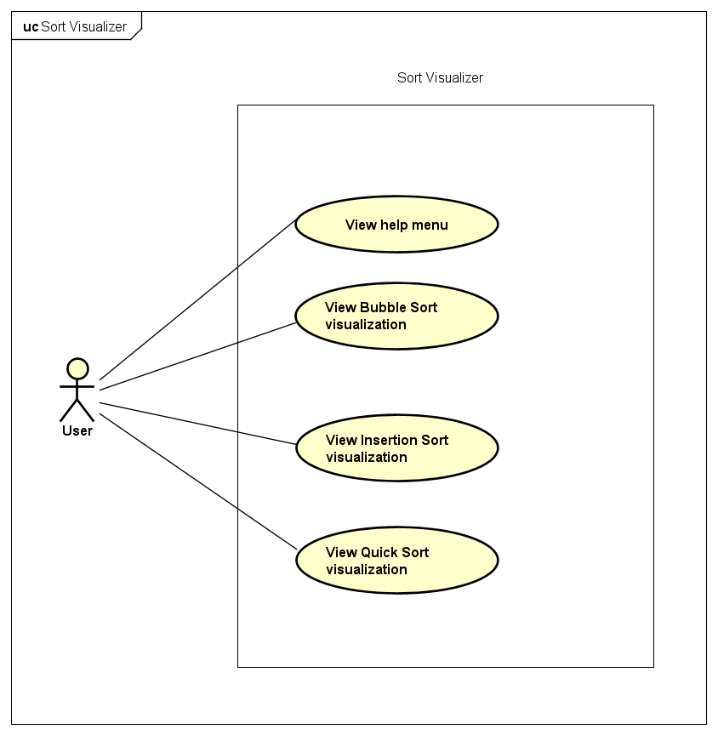

Use case Diagram

Slide 4
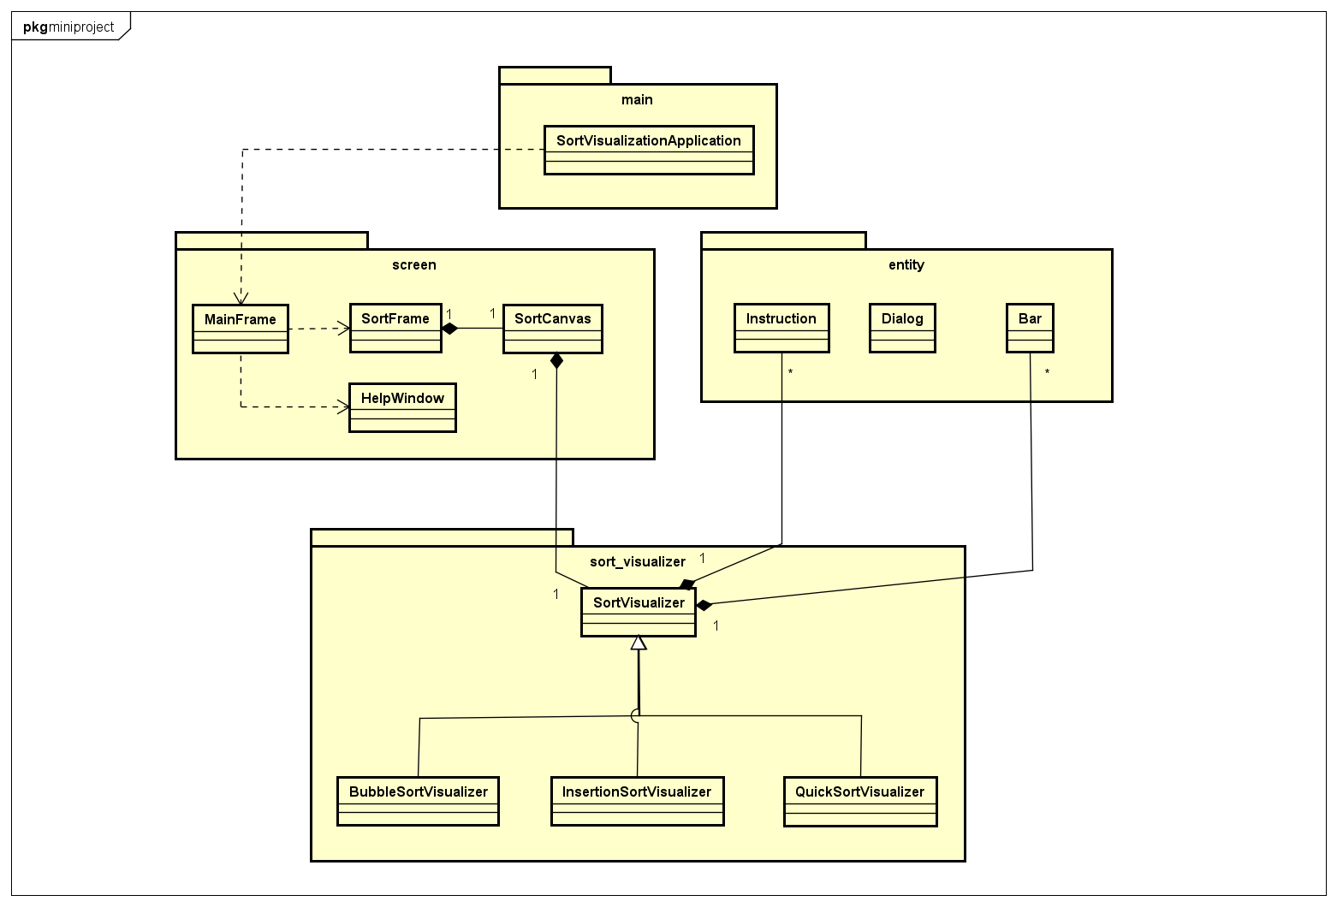
General Class Diagram

Slide 5
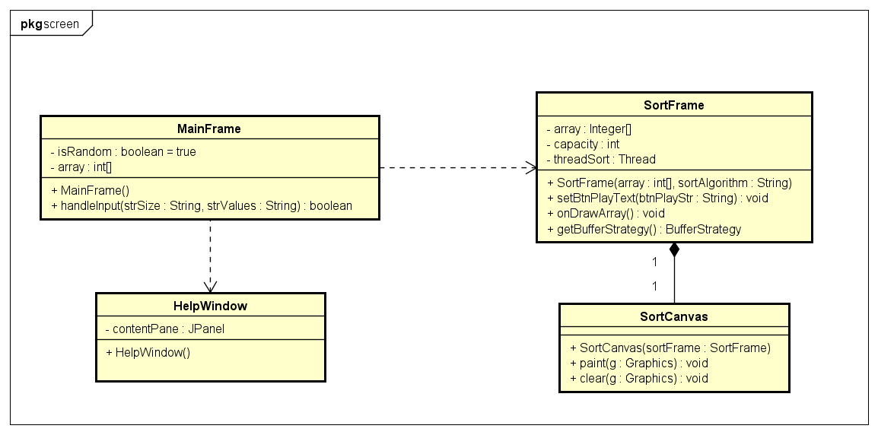
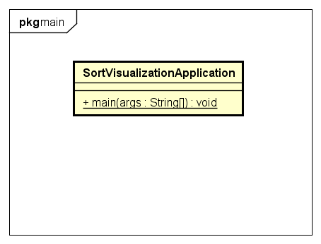
Class Diagrams

Slide 6
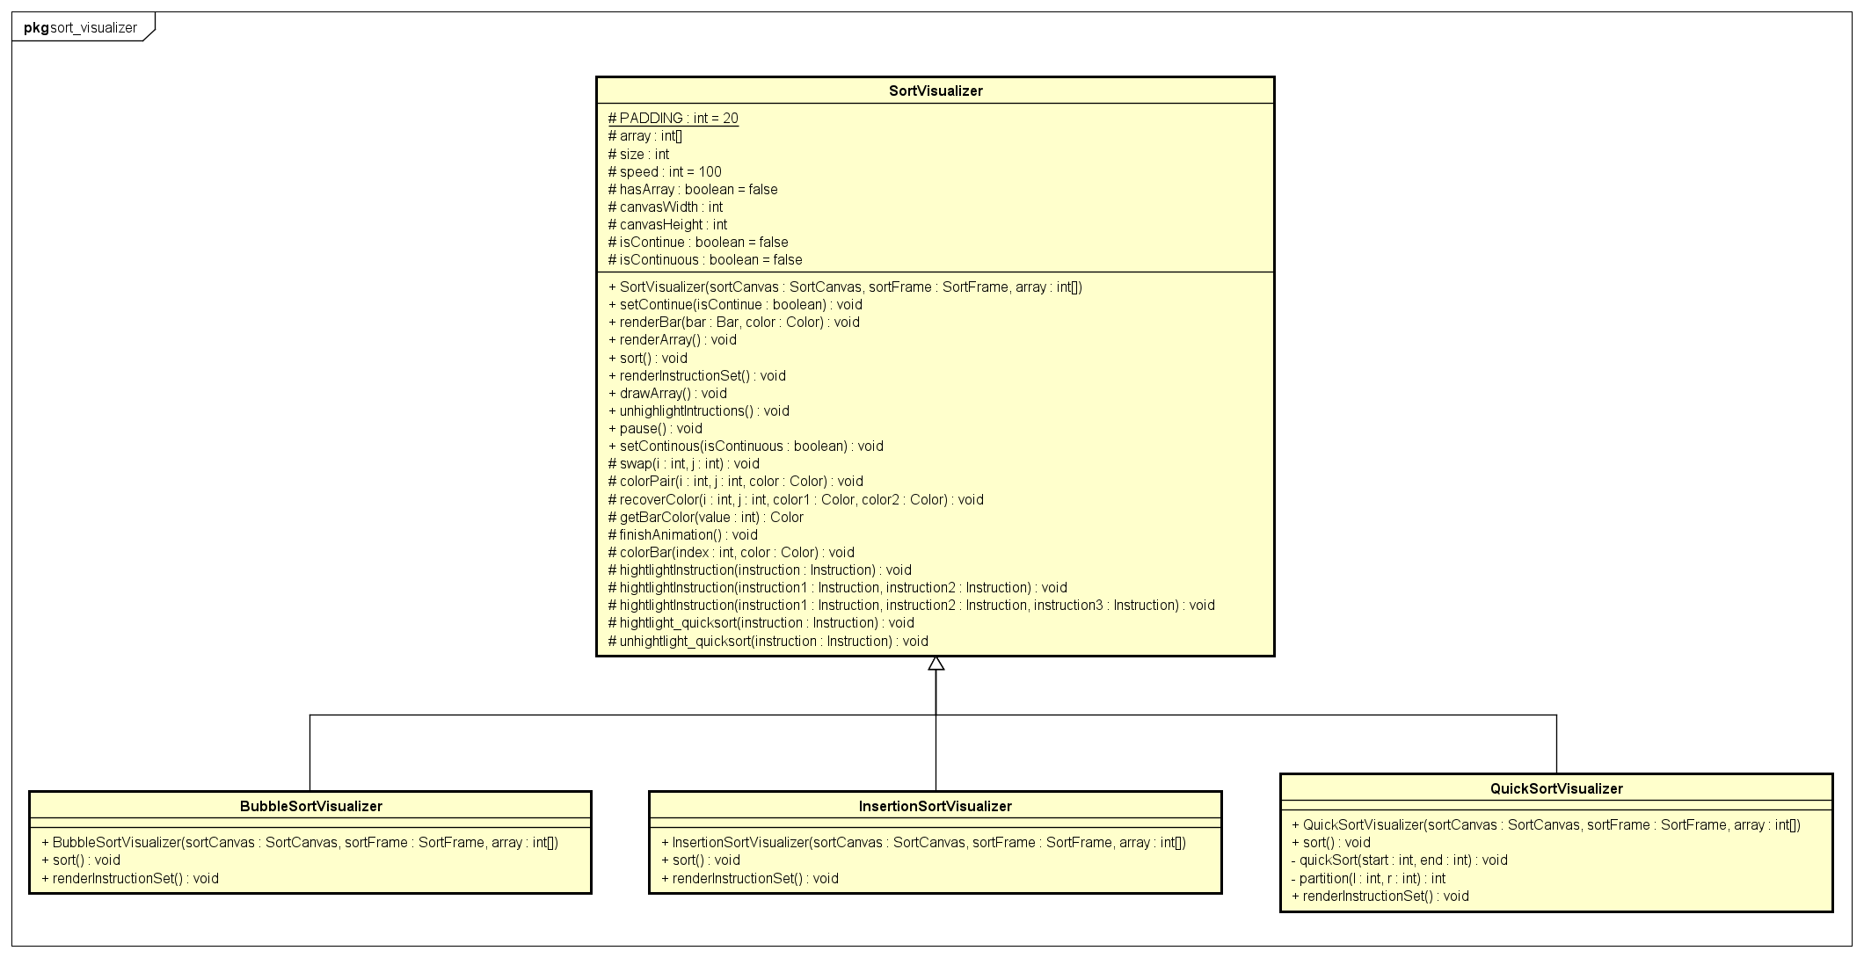
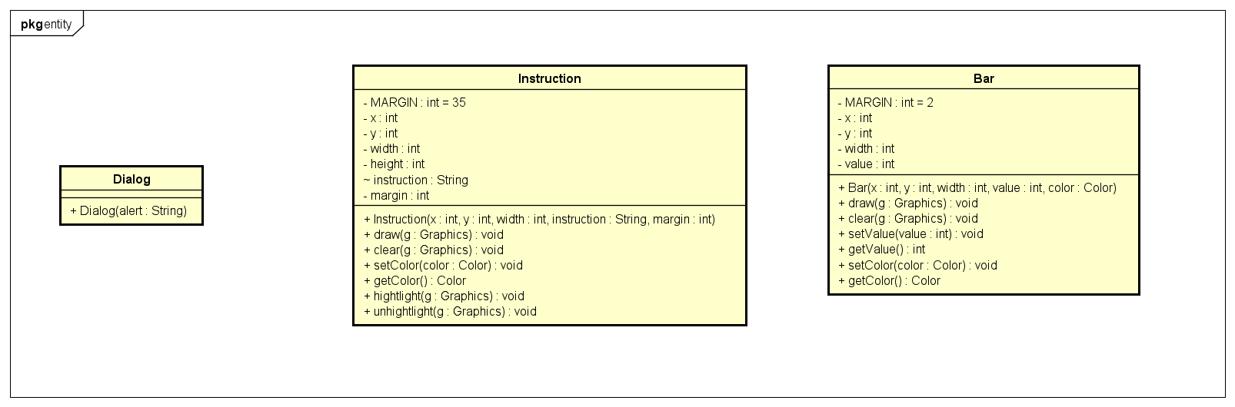
Class Diagrams

Slide 7
OOP techniques
Polymorphism
Inheritance
Association

Slide 8
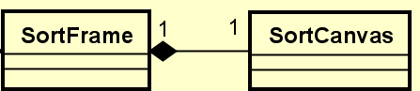
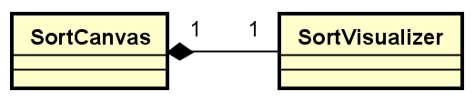
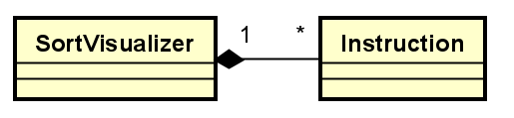
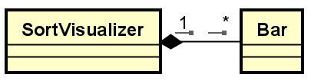
Explanation of Design
Association
Inside SortFrame class, we instantiate a SortCanvas object
SortCanvas cannot exists independent of SortFrame
SortVisualizer draws objects and do animations on SortCanvas
SortVisualizer cannot exists independent of SortCanvas
SortVisualizer uses mulitple Instruction objects.
Instructions cannot exists independent of SortVisualizer.
SortVisualizer uses mulitple Bar objects.
Bars cannot exists independent of SortVisualizer.

Slide 9
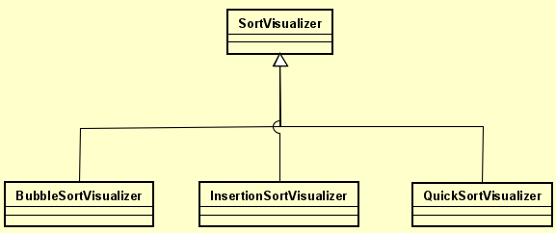
Explanation of Design
Inheritance - Polymorphism
* Inheritance:
Three sort visualizer share attributes such as: array of instructions, array of bars, speed of animations, etc.
They also share methods such as: render initial array, swap bars, highlight instructions, etc.
* Polymorphism:
Each sort algorithm associated to different set of instructions and mechanism for sorting.
Override 2 methods renderInstructionSet() and sort() in three child classes.

Slide 10
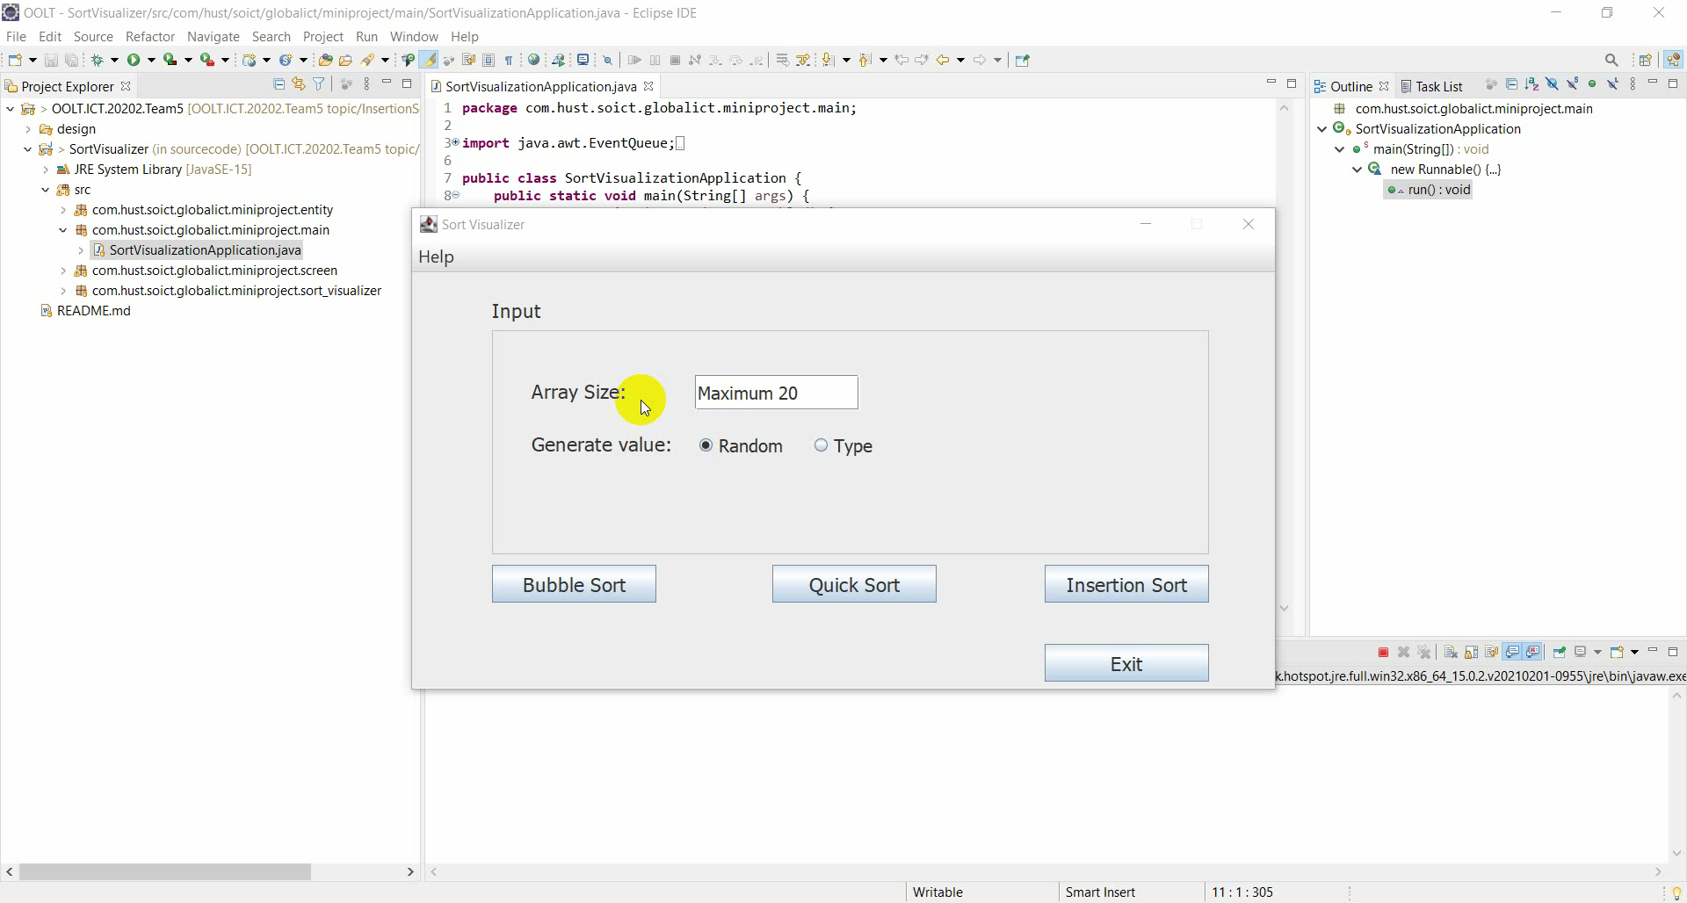
Demo scenario

Slide 11
THANK YOU

